Slide 1
My ESR
supervisor
self-service
guide
take this quick tour
to find out what is available
for you
(includes additional notes)
Nov 2019
Notes:
A quick tour of your Manager/Supervisor dashboard showing what is there for you and how you can use it.

Slide 2
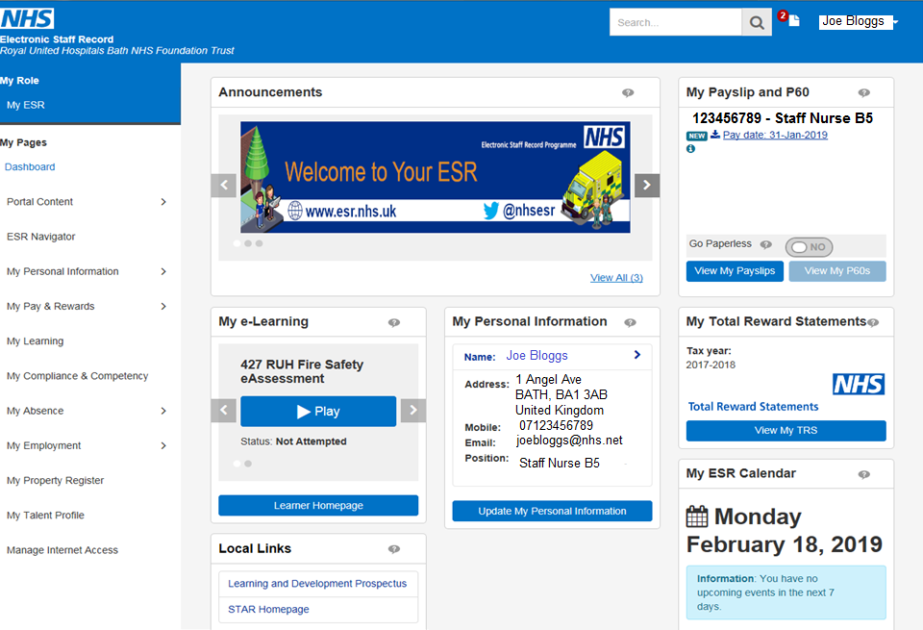
Click here & then click on manager to access your manager/supervisor dashboard
Notes:
Launch ESR to access your dashboard. Click on My ESR as shown & then click on manager to access your manager/supervisor dashboard.

Slide 3
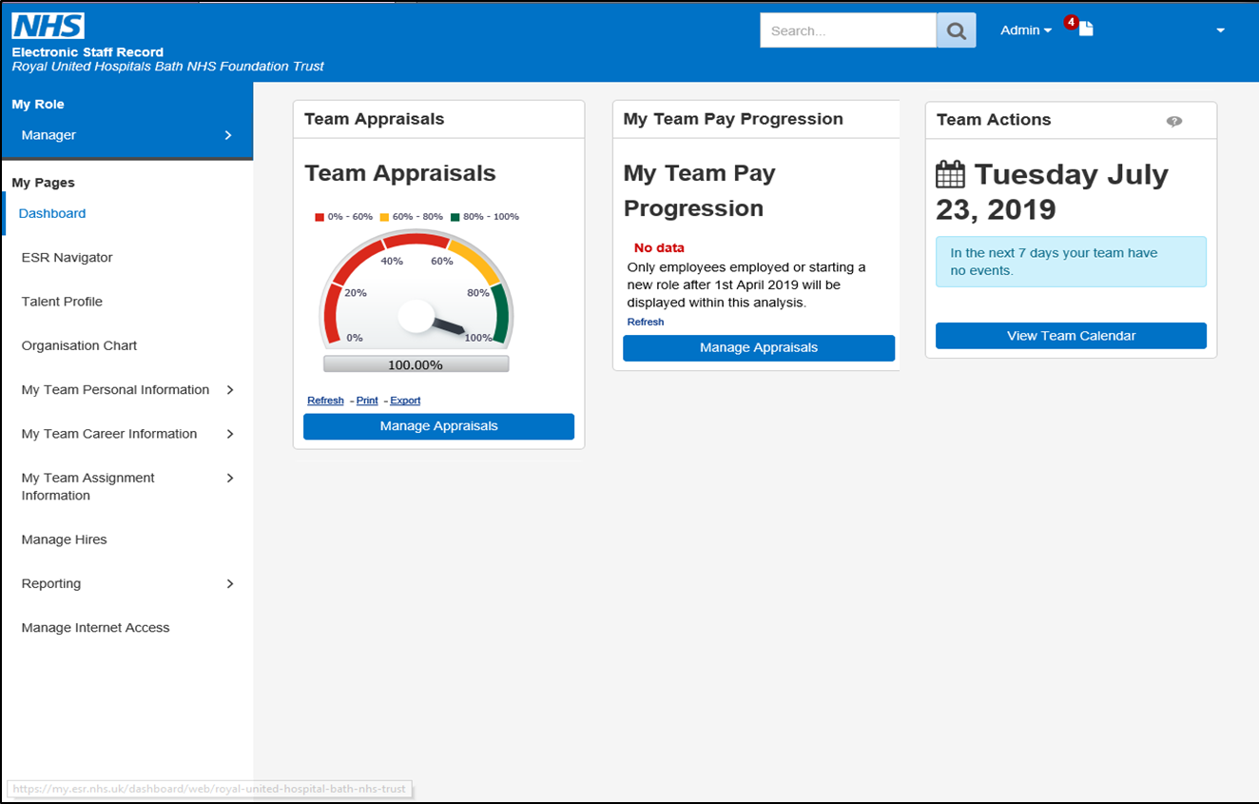
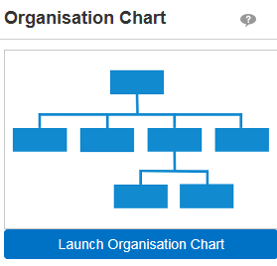
Your manager/supervisor dashboard showing the portlets currently available to you & the navigation pane on the left hand side.
Notes:
This is what your manager/supervisor dashboard will look like with a number of portlets displayed and a navigation pane down the left hand side.
If you click on My Team Personal Information on the left hand side this is where you can see information like home addresses, emergency contact numbers. You may want to ask your team members to ensure they have the correct personal details in ESR. They can do this themselves via the My ESR Personal Information portlet.
After any action in the portlet clicking on the portal icon (top right hand corner) will take you back to your manager/supervisor dashboard.

Slide 4
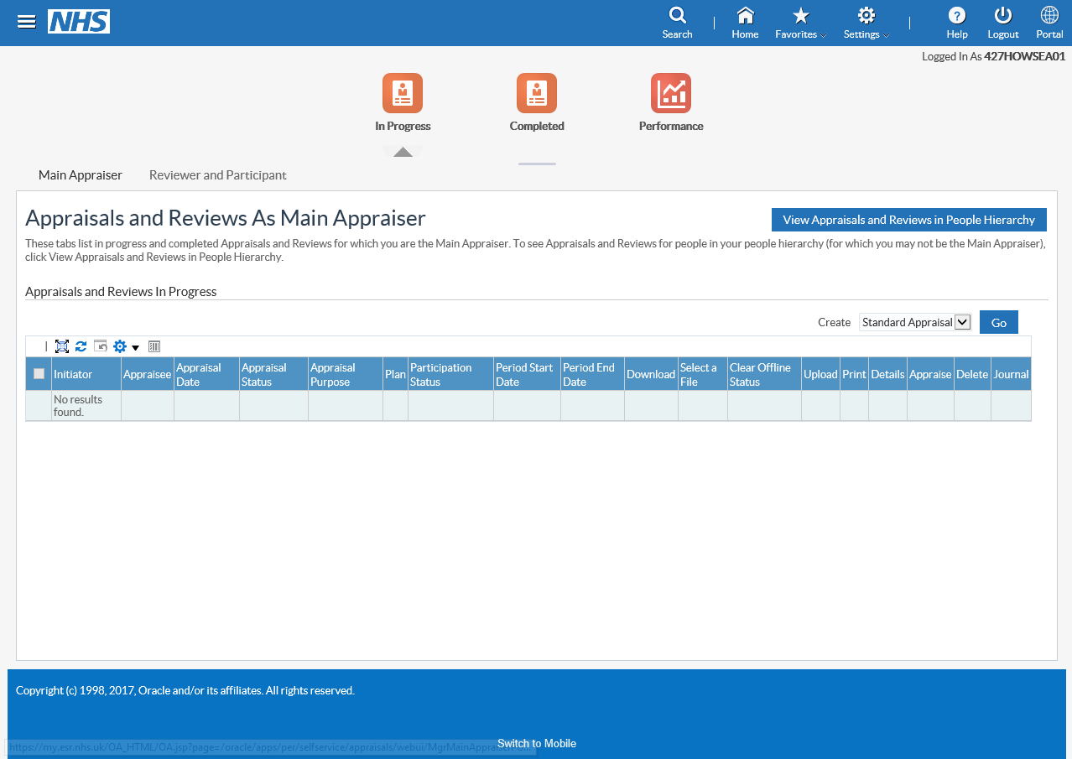
A visual representation of current appraisal compliance for your hierarchy
(this includes new starters)
Portlets
Team Appraisals
Team Appraisals Cont.
My Team Pay Progression
Team Actions
Organisation Chart
Clicking here will allow you to view existing appraisals within your teams hierarchy, record new appraisal dates & upload completed appraisal documentation.
‘How to’ guidance will be available to show you how to do this.
Notes:
You can see the appraisal compliance for your hierarchy. Please be aware that this will also include any new starters so if you were expecting it to be 100% and it is not, this maybe the reason. You can check by clicking on Manage Appraisals.
When you have carried out an appraisal click on Manage appraisals to record the date & upload completed appraisal documentation. A separate How to Guide is available to help you with this.

Slide 5
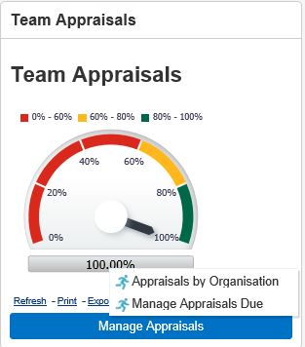
Portlets
Shows current compliance within your hierarchy
(this includes new starters)
Team Appraisals
Team Appraisals Cont.
My Team Pay Progression
Team Actions
Organisation Chart
Clicking here will show you two options:
Appraisals by Organisation & Manage Appraisals Due. Clicking on either of these will open up a Business Intelligence (BI) report detailing upcoming appraisals
Notes:
Clicking on the grey compliance % strip opens up business intelligence (BI) report. This is where you can find out more about compliance status for the teams within your hierarchy and monitor appraisal activity.
Please be aware that you will receive a revised appraisal reminder email for the next few months. This will guide you to view your appraisal information here.

Slide 6
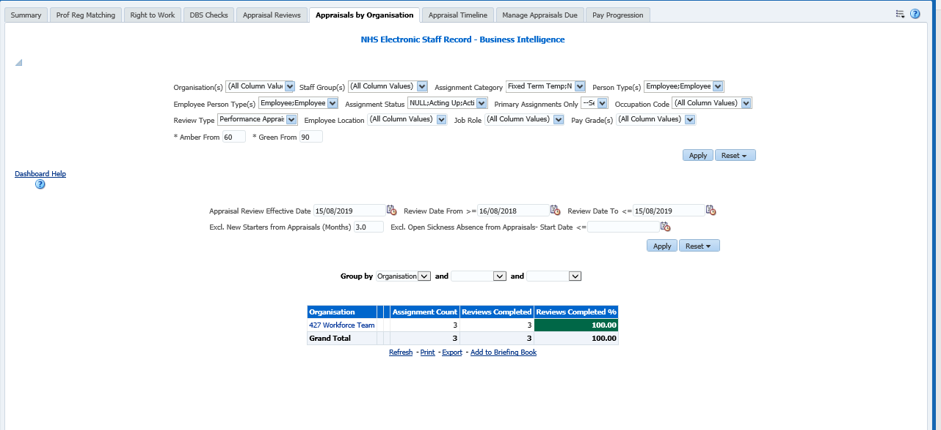
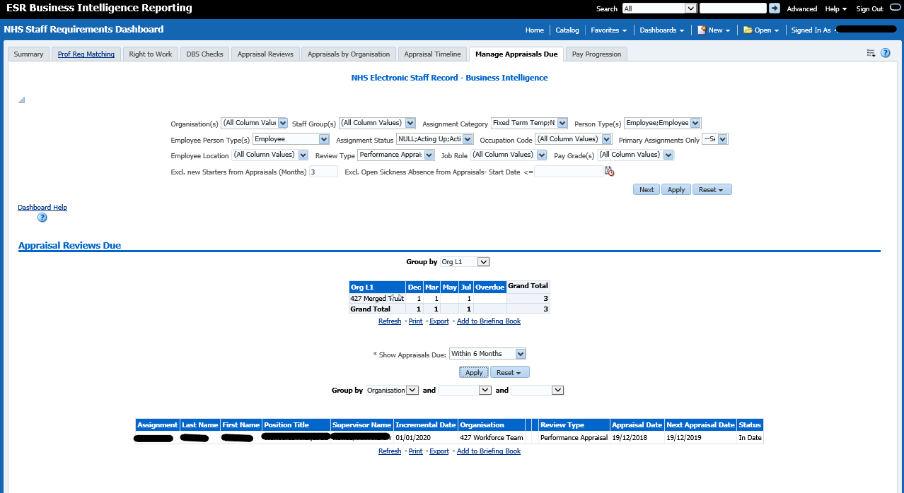
Appraisals by Organisation
Useful for appraisers who manage staff over multiple areas, this BI report will allow you to see a summary of the compliance at different organisational levels.
Manage appraisals Due
This BI report allows the named supervisor to monitor when appraisals are due for their team. A drop down box can filter this list by Due now, 1 month, 3 months and 6 months
Notes:
More detail about the BI reports available.

Slide 7
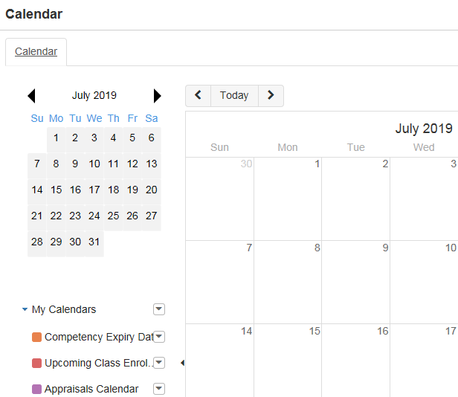
Summarises any upcoming (next 7 days) date related actions held in ESR for your teams eg. appraisal, fixed term contract end
Portlets
Team Appraisals
Team Appraisals Cont.
My Team Pay Progression
Team Actions
Organisation Chart
Clicking here will allow you to scroll through your ESR calendar to see any upcoming events for your team members

Slide 8
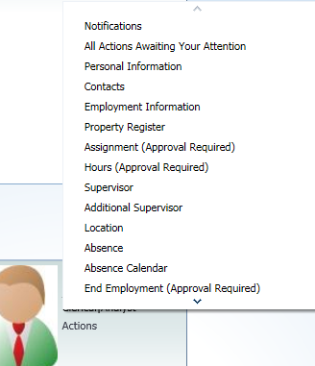
Click to see staff in your reporting hierarchy chart.
The information you see depends on how your dept. hierarchy structure has been set up.
Please see note below re: keeping your hierarchy up to date.
Portlets
Team Appraisals
Team Appraisals Cont.
My Team Pay Progression
Team Actions
Organisation Chart
Once your organisation chart is launched click on actions under staff members name to bring up menu and view staff members information directly
Notes:
The information that you will see depends on how your department structure has been set up – this is the Reporting Hierarchy. As a Manager/Supervisor you will be able to view information for your direct reports and for anyone further down the ESR hierarchy. In ESR Level 1 (L1) of the reporting hierarchy is your direct reports. Level 2 is the next level down and so on. You can view your staff information directly once you launch your organisation chart.
It is key that we keep your hierarchy information up to date to ensure the right staff see and are able to manage information for the right people. Each month you will receive an email asking for any updates. It is vital that you complete and return this to us with any changes.

Slide 9
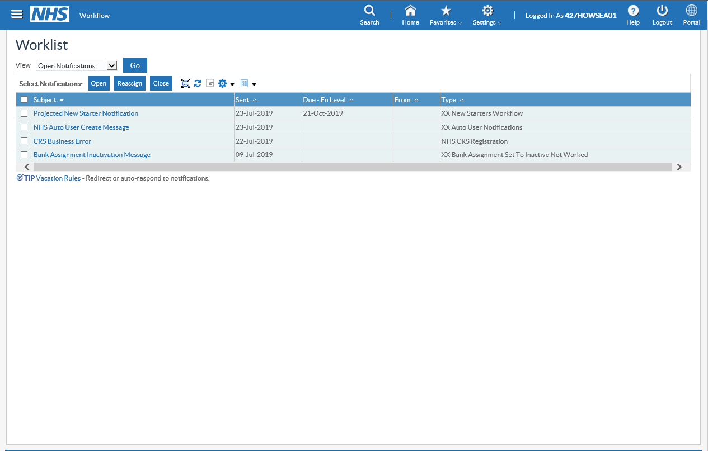
Notifications
Any notifications will show in the top right hand corner of your manager/supervisor dashboard
Clicking on the icon will give you a list of all your notifications. Most will be for information only but you are required to acknowledge that you have read them
Providing you have an NHS mail address recorded in ESR, notifications will be sent to your ‘in box’ where you can read/action them.
A ‘How to Guide’ is available
Notes:
Ensuring you have an email address in ESR will enable you to receive your notifications to your ‘in box’. The majority of these will be for your information only. The notifications will also appear on your manager/supervisor dashboard. To clear these you do need to acknowledge them as only reading them via your ‘in box’ does not clear them – sorry!
There is a How to Guide to help you understand the notifications you will be receiving.

Slide 10
If you have any queries regarding your
supervisor self-service
please contact
ESR Self-Service
ruh-tr.esrselfservice@nhs.net
Thank you

